Slide 1
Professional skills for data science
Data structures Ed Harris

Slide 2
Objectives
Basic data types in R
Data with factors
class() and converting variables
Vector and Matrix fun
Practice exercises

Slide 3
Basic data types in R
Concept of “Data Objects”
Data you can use is in the Global Environment
Data Type refers to the kind of data (important for computers)
Data Type is determined automatically in R (by the passive-aggressive Butler)
You often will need and want to tweak data type

Slide 4
Basic primitive types in R
a <- 1 # numeric mode(a) a <- "1" # character mode(a) a <- '1' # character mode(a) a <- TRUE # logical mode(a) a <- 1i # complex mode(a)

Slide 5
Basic data types in R
NULL means undefined value (absence of a vector)
is.null() function can check it
NA means missing value (not available)
is.na()
inf means infinity e.g. 1/0 of -1/0
is.infinite()
NaN means an invalid number e.g. 0/0
is.nan()

Slide 6
Basic data types in R
my_list <- list(a = 1, b = 2) my_list <- my_list$c # Element 'c' doesn't exist, Output: NULL na_addition <- 5 + NA print(na_addition) # Output: NA

Slide 7
Basic data types in R
There are some rules for naming data objects
Can contain letters, numbers, some symbolic characters
Begin with a letter, Does not contain spaces
Some things are forbidden, @, %, #, etc.
Should be human-readable, consistent, and not too long

Slide 8
Basic data types in R
x1 <- 5 x2 <- "It was a dark and stormy night" # hard to read my_variable_9283467 <- 1

Slide 9
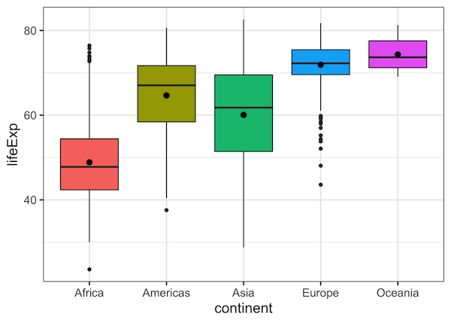
Data with factors
Let’s you want to analyse categorical data.
Sometimes this is called a “factor”.

Slide 10
Data with factors
Two types of factors
Non-ordered factors : the levels are the names of the categories cows = Martha, Ruth, Edith
Ordered factors: have a specific order dose = Control < Half < Full

Slide 11
class() and converting variables
# non-ordered factor variety <- c("short", "short", "short", "early", "early", "early", "hybrid", "hybrid", "hybrid")

Slide 12
Vector and Matrix fun
Ways of organizing data
Vector - Homogeneous and One dimensional from 1 to i, my_vec[i]
Matrix - Two dimensions rows, columns, my_mat[i, j]
Array - Generalized matrix with n dimensions, my_array[i, j, k]

Slide 13
Vector and Matrix fun
# Vectors myvec1 <- c(1,2,3,4,5) myvec1 class(myvec1) myvec2 <- as.character(myvec1)

Slide 14
Vector and Matrix fun
vec1 <- 1:16 vec1 mat1 <- matrix(data = vec1, ncol = 4, byrow = FALSE)

Slide 15
Lists
Unlike vectors and matrices, lists can hold elements of different types. Each element in a list can be a vector, matrix, data frame, or even another list
# Creating a list my_list <- list(name="John", age=25, scores=c(90, 85, 88)) print(my_list)
You can access elements in a list using the $ operator or double square brackets [[]].

Slide 16

Practice Exercises

